Slide 1
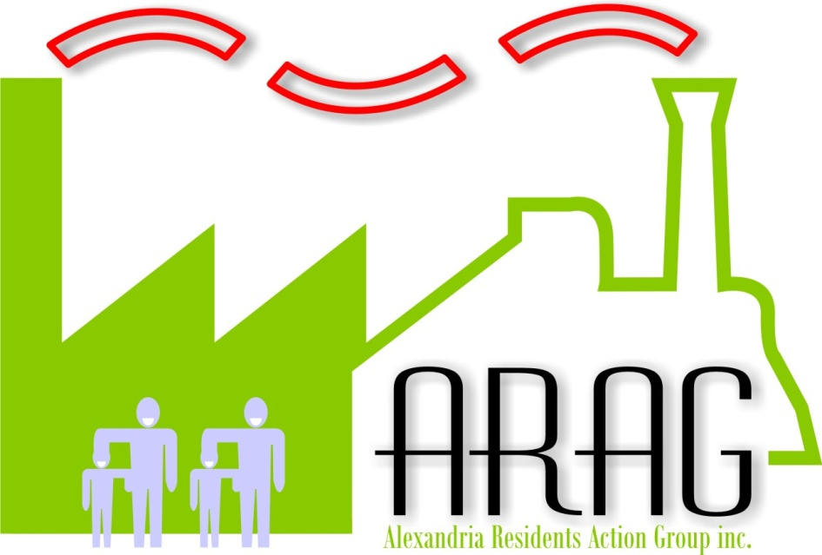
Alexandria Residents’ Action Group
8 June 2017 Meeting
Alexandria Town Hall

Slide 2
Agenda
  Traffic calming/management
  Update on Act4Alexandria
  Ideas for posting Act4Alexandria on social media
  Other business
  Welcome to Cr Jess Miller

Slide 3
Traffic Calming/Management for Alexandria

Slide 4
Traffic Calming/Management for Alexandria
Suggestion from John Eleftheriou (resident of Alexandria) re the laneways (Belmont, Lawrence and Euston) to minimise the laneways being used as high-speed rat-runs by drivers trying to avoid the inevitable congestion on Euston and Mitchell Roads.
Make all the lanes ONE-WAY, but alternating blocks - Belmont Lane between Huntley & Maddox one-way South, between Maddox and Harley, one-way North, switching back again between Harley & Fountain
Then alternate the directions for Lawrence lane etc
Only a small inconvenience for locals, garbage trucks etc, but more painful for rat-running.
Minimal cost – just the cost of about 18 signs!

Slide 5
163-173 Euston Road - DA
DA 2017/238
Stage 1 development application for demolition and concept mixed use proposal for 3 building envelopes, including 2 basement parking levels with vehicle access to McEvoy Street, a 6 storey mixed use building to McEvoy Street with ground floor retail and residential above, a centrally located 6 storey residential building and a 3 storey residential building to Lawrence Street.
The application is Integrated Development requiring approval under the Water Management Act 2000.
Update from David Reynolds, Senior Planner, City of Sydney
8/6/2017 - Design Advisory Panel presentation by David Reynolds on the DA (not open to the public)
Subsequently, a report will be provided to the developer on the DA by the Council raising issues – this could lead to the developer re-submitting the DA or could mean they go direct to the Land & Environment Court for determination.

Slide 6
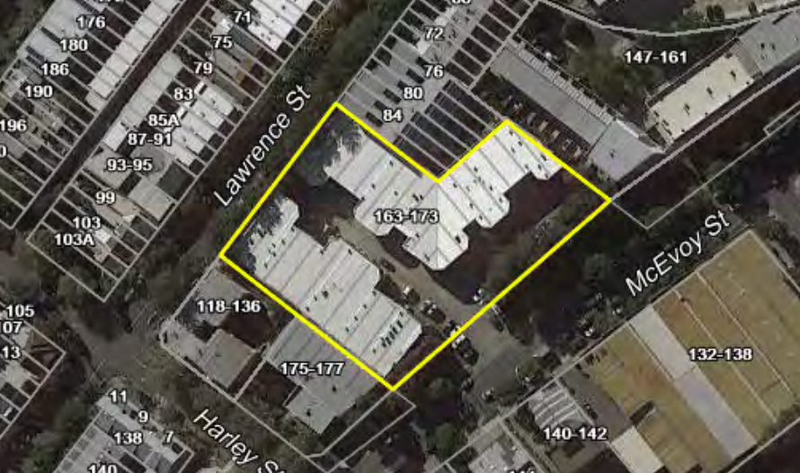
163-173 Euston Road - DA

Slide 7
Act4Alexandria
  Campaign for Alexandria residents to ACT 4 Alexandria and focus their anger on two critical issues:
  The McEvoy St/Euston Rd widening
  The lack of a Metro station for Alexandria

Slide 8
Next meeting
  ??
  Other suggestions are welcome!

Slide 9
THANK YOU
Alexandria Residents Action Group (ARAG)
info@arag.org.au

