Slide 1
Agenda
Australian Technology Park - Mirvac building plan is on exhibition until 29 February
WestCONnex – where to now?
Alexandria Sunday FunDay – 20 March – save the date!
Update on the Alexandria Hotel

Slide 2
Central to Eveleigh has started

Slide 3
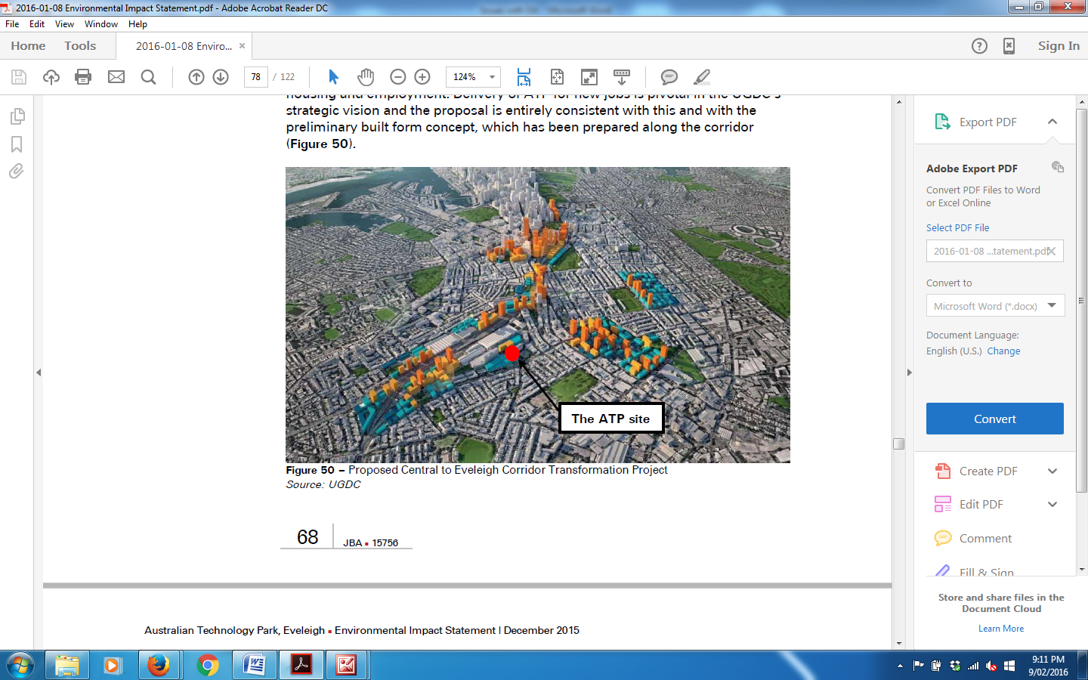

Slide 4
The sale of ATP to Mirvac is the first stage.
The “State Significant Development”
Environmental Impact Statement for the ATP is currently on exhibition until 29 February.
What will it be like?

Slide 5
The EIS tells us that there will be:
Lots of construction until 2019 -2020.
  Monday to Friday – 7am to 6pm
  Saturday – 7am to 5pm
  New road egress at Alexander Street
  Stockpile on Vice Chancellors oval
3 new buildings (that don’t comply with the existing Development Control Plan)
Extra 10,000 workers (relocating from Parramatta and Olympic Park)
24 hour 7 day operations
More crowded trains
More traffic

Slide 6
The EIS tells us that there will be:
Operational Noise
More traffic noise
Reflexivity
26 large commercial waste bins to be emptied and taken away each day
Lots of community facilities in multipurpose building (mainly for workers but maybe we can also use some)
  Child care, retail, gym, supermarket – 24x7
  Community offices ????
And lots more.....

Slide 7
From the EIS
“Buildings 1 and 2 are wider and generally exhibit greater bulk when compared to the existing Media City / Channel 7 building and other buildings within ATP”
What will it look like?

Slide 8
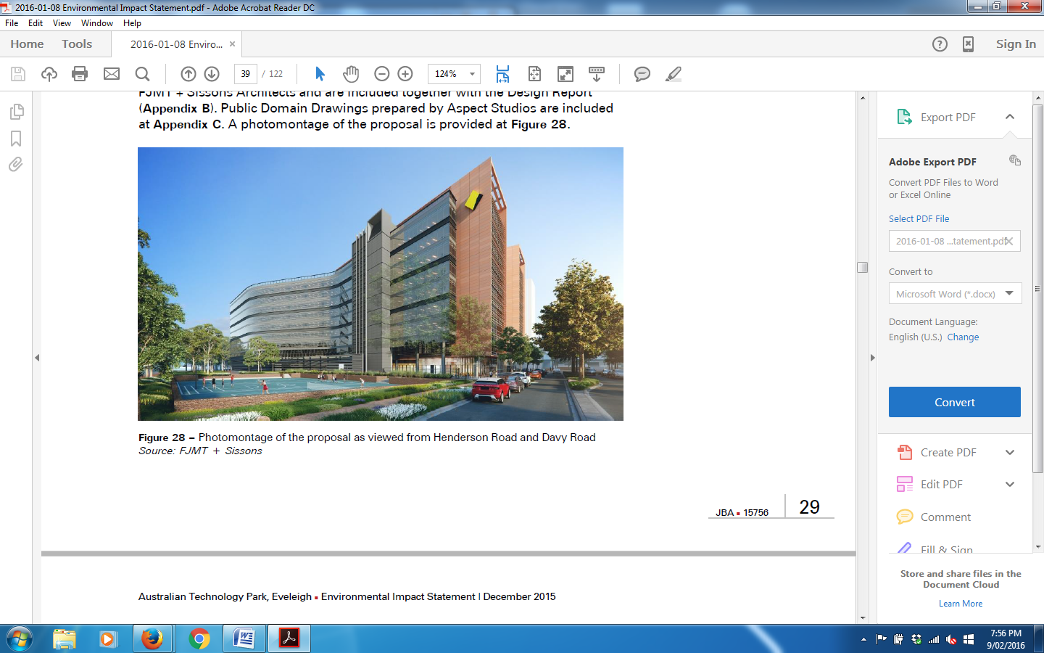
The “artist impression” of Building 1

Slide 9
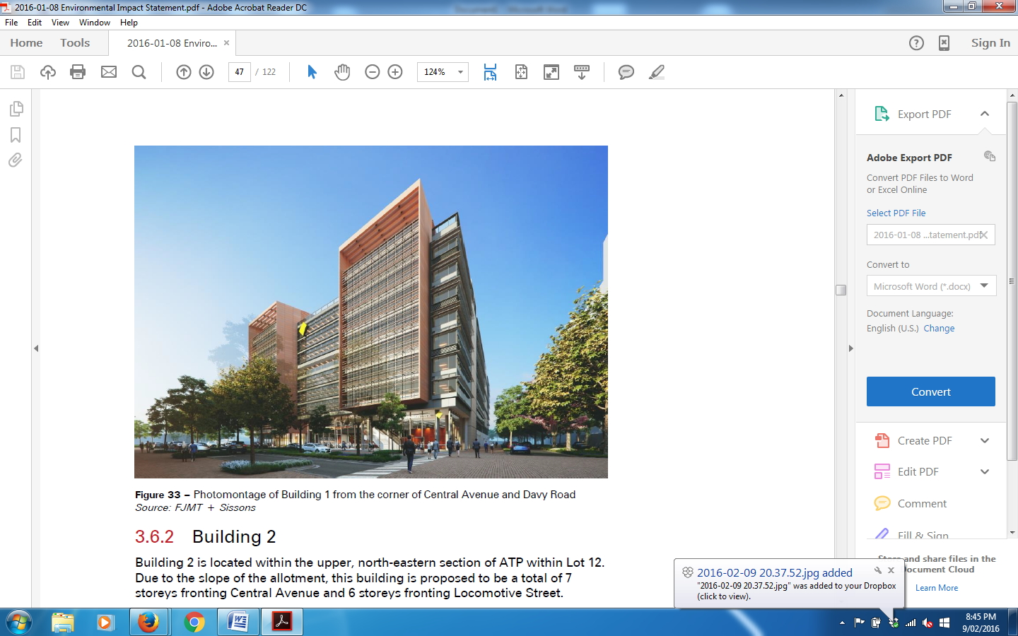
The “artist impression” of Building 1

Slide 10
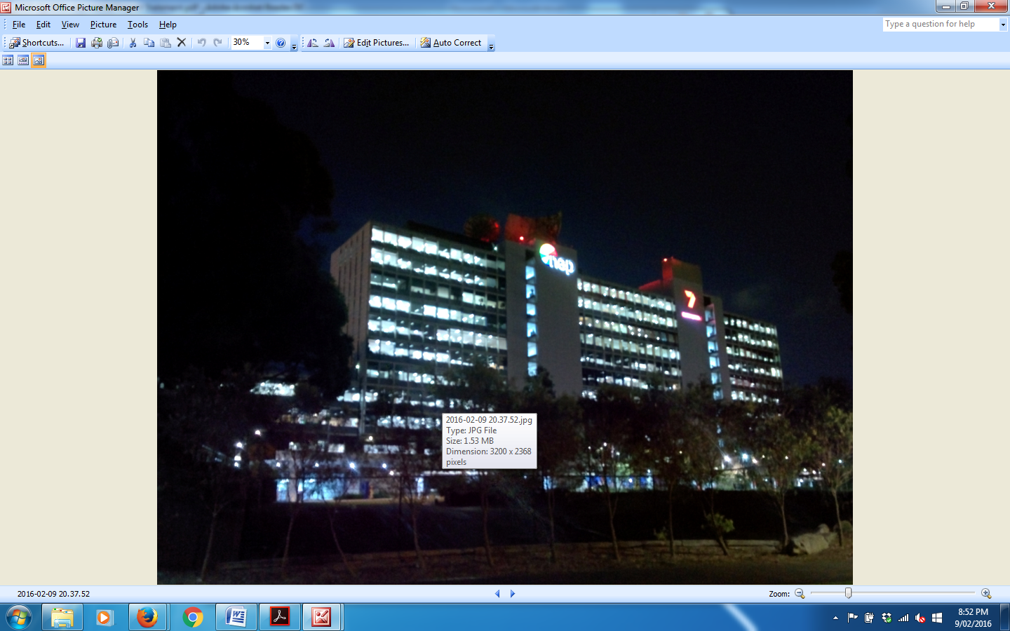
Picture of Channel 7 building now.
Imagine what it will be like with a long 9 Storey (excluding roof top plant) building between it and Henderson Road.

Slide 11
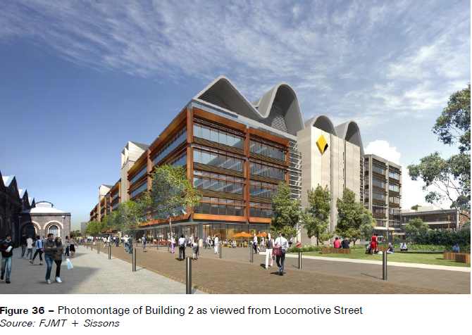
The “artist impression” of Building 2

Slide 12
Building 2 is huge.
It will stretch from the steps near the Channel 7 building all the way to the main path through the ATP.

Slide 13
Some issues with the DA/EIS:
1. The NSW Government has given the ATP to one of the ten largest most politically powerful organisations in Australia.
2. The DA/EIS documents are twisting and turning the facts and realities of the proud history of the ATP and the importance it plays in so many of our lives to meet the requirements MIRVAC must meet under the Secretary’s Environmental Planning and Assessment Requirements for DA’s
3. The ATP so called improvements - supermarket 24/7, cafes, gym, childcare, - are for the benefit of the CBA employees even though it is being marketed as benefits for the local community. Another CON. But MIRVAC can’t admit that as the EIS would not then meet many of the DA assessment criteria.
4. The so called Community Building is not for our communities. A complete and deceitful misnomer. The only small space not commercial in the building is very small and is really for commercial IT businesses, start-ups etc. The name of the building is a complete misnomer, a cynical PR exercise with no substance.

Slide 14
Some issues with the DA/EIS:
5. Alexandria and the residents of Alexandria are being sold out again. We are not even mentioned as one of the nearby suburbs. The wrong suburb names are on maps. It is not even subtle in how blatantly the authors of the documents have kept from mentioning that huge Building 1 will have serious impacts of light, noise, pollution and traffic on our homes in the streets directly opposite the ATP.
It’s almost as if we don’t exist…. even though our homes and streets are obvious in many photos.
6. The Traffic and Parking Section and Report facts are wide open to challenge. As far as I have read the section contains only data on the visitor parking not on the number of employees parking in the ATP. No mention of the cost of parking. Report needs to be thoroughly challenged. They are making claims that the intersection of Mitchell/Davey/Henderson will not be affected even though there will be an increase of 10,000 employees, West CON, Waterloo Station and the huge increase of residents there and of course Ashmore, and the new units in Mitchell and surrounding streets.
It is a breach of the DA requirements that these factors do not appear to have been taken into consideration.

Slide 15
Some issues with the DA/EIS:
7. No information has been given of where the employees will be travelling from and how many live out west; how many will have to drive if working shift work or unable to manage child and pram on peak hour trains if child in child care at the ATP.
8. Anybody who uses the trains to the Western suburbs knows how crowded the trains are at peak times and unfrequent at other times so to claim that the train and bus services are excellent and of a quality standard is a complete farce. Unless Redfern Station is improved greatly the Station will become impossibly overcrowded and will become even more unsafe with the influx of the CBA employees. MIRVAC is encouraging people to use the Station and the trains, buses and bikes. Long way to bike from Parramatta!
9. ATP will be operating 24/7. Call centre staff, gym, supermarket, delivery trucks, etc so traffic in and out of the ATP via Mitchell/Davy/Henderson will be 24/7. Rubbish trucks daily.
10. Building will begin in 2017 and will continue til buildings open in 2019, 2020. work on the building will be six days a week beginning during the week at 7am.

Slide 16
Some issues with the DA/EIS:
11. Size of Buildings 1 and 2 are massive and will impinge on what ever they are near. 2 will completely obliterate the Locomotive Workshops completely destroying the whole historical and cultural aspects of the ATP. Incredible destructive and sad. Yet MIRVAC boasts of enhancing the heritage of the ATP.
12. Building 1 shadows will affect the homes and childcare in Lyne, Alexander and Henderson roads. It is built very close to the Henderson Road and will loom over the footpath as it is so close.
13. Our homes. Our walkability and safety through the Park being threatened by traffic massively increased in and out of the ATP especially across the crossings inside the ATP.
14. In the final count objecting to the DA is our responsibility. Not Redwatch's. Not ARAG's. Ours as residents.
This is our battle as individual residents. especially those of us whose homes and lifestyles are under threat.

Slide 17
Some issues with the DA/EIS:
What will you do about the situation?
Sit and wait to see what happens as occurred with the Channel 7 building?
Challenge the development and hope to influence what is built?
Best to choose the Sections of the DA/EIS which you feel most passionate about or you have expertise in that area. The documents are easy yet confronting to read and very easy to spot the weaknesses.
Rule of Thumb

Slide 18
We all need to challenge this EIS. and remember
This is only the beginning of the Central to Eveleigh project.

Slide 19
WesCONnex – where to now?
Petitions to the Auditors-General to do a complete audit of WestCONnex – copies available – take copies and get them signed!
Proposed motion
“ That the Alexandria Residents Action Group fully endorse the submission made to the NSW Planning Department in response to the Environmental Impact Statement on the M5 extension without reservation.
Further, that the Alexandria Residents Action Group reject the WestCONnex project in its entirety as a solution to Sydney’s traffic and transport issues.
We demand that the entire WestCONnex Project be halted immediately and call upon the Federal and State Auditors General to audit the project and report on their findings as a matter of urgency.”

Slide 20
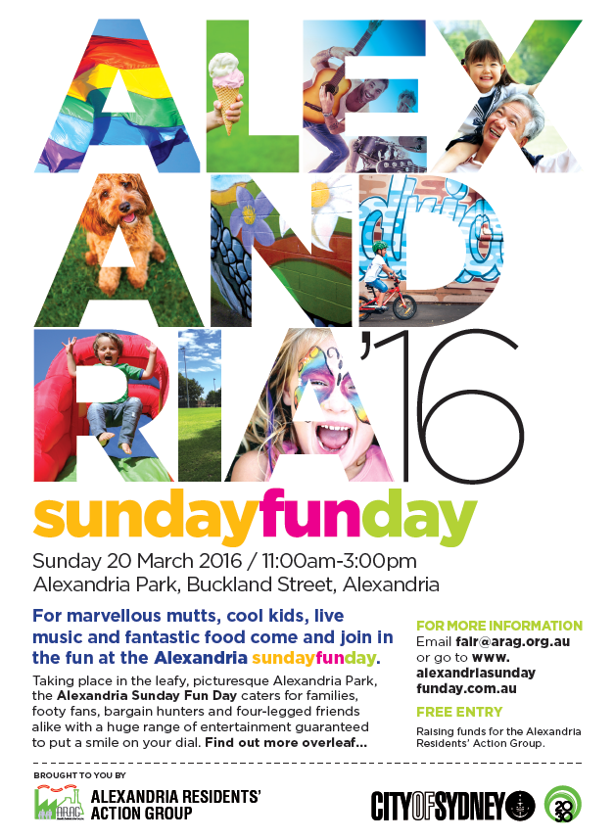
Alexandria Sunday FunDay
Need more volunteers to help before and on the day:
  Putting up posters
  Delivering flyers
  ARAG BBQ
  Set up and pull down
Like the Facebook page and share with friends
Keep an eye on the website http://alexandriasundayfunday.com.au

Slide 21
Alexandria Hotel - update
City of Sydney Council legal team have advised that the applicant has discontinued their appeals in relation to
the hotel

Slide 22
Other business?

